Slide 1
FYP Meeting: Results and discussion
Anna Bakewell
09/12/2020
Notes:
Comparative RNA-sequencing analysis of gene activity during mouse intestinal differentiation as a model for adult stem cell differentiation

Slide 2
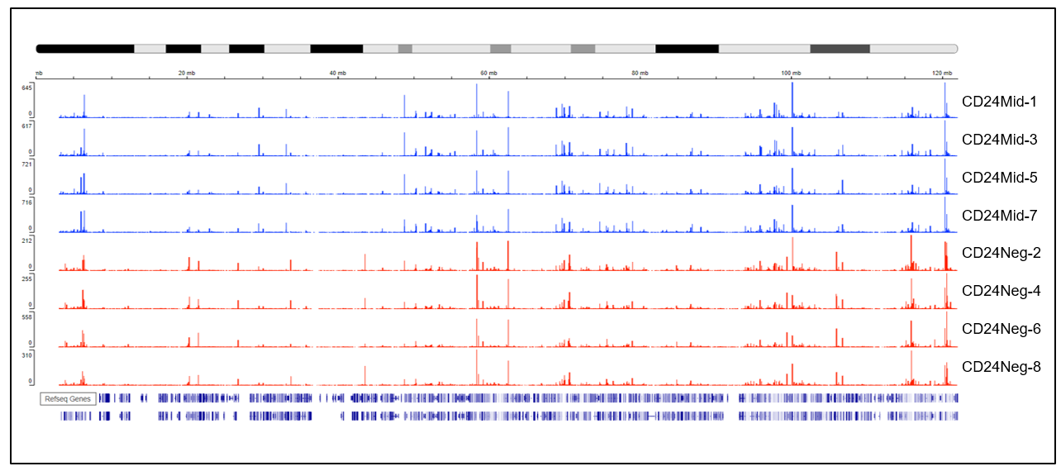
Data visualisation and exploration: IGV plot
Coverage track of mapped reads to mm10 chromosome 11
Notes:
The BAM formatted files were converted to bigwig. format so that the coverage track of mapped reads to chromosome 11 of the mm10 mouse genome could be visualised.
Shown here again because I wanted to show the most significant up and down regulated genes.

Slide 3
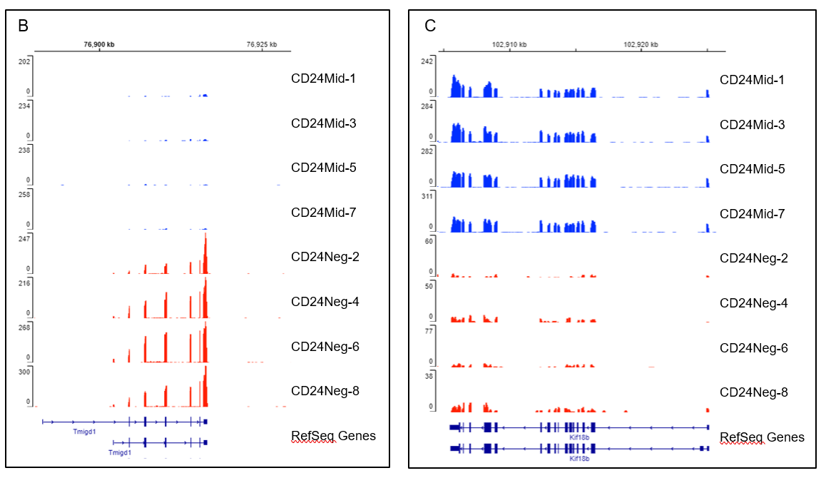
Notes:
These are represented here. These genes displayed the greatest differential expression between the sample groups.
Red: higher expression of TMIGD1 (transmembrane and immunoglobulin domain-containing protein 1) in differentiated cells.
Blue: higher expression of KIF18B (kinesin family motor protein) in the undifferentiated cells

Slide 4
Differential Gene Expression

Slide 5
Summary
Are the genes that are up/down regulated related to cell differentiation?
If there are no reports of direct relation to differentiation does the gene have a potential influence on characteristics of undifferentiated small intestinal (SI) stem cells vs differentiated cells
Examples: Maintaining cell growth, mitotic processes, transport
Examples: TSG, suppression of genes associated with cell proliferation

Slide 6
Summary
Can the roles of the highest DE genes in regeneration of the small intestine be further investigated?
KD/KO studies
Pathway inhibition (where commercially available inhibitor compounds exist)
Investigate which genes could be reactivated/silenced to improve reprogramming of differentiated SI cells back to progenitors
5’-hmC expression data

Slide 7
DGE: higher expression in CD24Neg samples
Gain of expression
TMIGD1
SLC47A1
ACE
SLC16A3
ASPA

Slide 8
Tmigd1
Gain of expression
Tmigd1 = transmembrane and immunoglobulin domain-containing protein 1
Cell adhesion molecule predominantly expressed by epithelial cells of the intestine and kidney
Expression downregulated in colon and renal cancers suggesting TS activity
Induces G2-M cell cycle checkpoint arrest in colon cancer cells
KO leads to development of adenomas in small intestine and colon
Notes:
Table shows top 10 most significantly DE genes with increased logFC.

Slide 9
ACE
Gain of expression
ACE = angiotensin-converting enzyme (aka CD143)
Cleaves angiotensin I to angiotensin II
Member of intestinal brush-border membrane enzymes
Angiotensin signalling → tumorigenesis, tumour proliferation and metastasis
May be involved in modulation of intestinal epithelial cell apoptosis
Study showed higher proliferation rates in ACE KO mice and absence of ACE leads to marked increased expression of GFRs
Notes:
Angiotensin I-converting enzyme gene plays a crucial role in the pathology of carcinomas in colorectal cancer - PubMed (nih.gov)
Modulation of mouse intestinal epithelial cell turnover in the absence of angiotensin converting enzyme - PubMed (nih.gov)
Marked decline in enterocyte apoptosis was associated with decreased gene expression of TNF-alpha.
Could it be important for maintaining turnover of small intestine?

Slide 10
DGE: reduced expression in CD24Neg samples
Reduced expression
KIF18B
RPA1
TK1
NUP85
PELP1

Slide 11
KIF18B
Loss of expression
KIF18B is a member of the kinesin family of motor proteins
Activates the Wnt/β-catenin signalling pathway
Silencing reduces expression of Cyclin D1, β-catenin, C-myc and reduced phosphorylation of GSK3β
KD induces cell cycle G1-phase arrest and inhibits proliferation, migration and invasion of cervical cancer cells
Notes:
Overexpression promotes proliferation, migration and invasion of cervical cancer cells.
KIF18B is closely related to the pairing and separation of chromosomes in mitosis. Involved in controlling MT length and centering the mitotic spindle at metaphase.
Study found enrichment of the cell cycle pathway was found for most of the genes co-expressed with KIF18B.
Second study showed that KIF18B controls b-catenin expression at the transcript level. May contribute to regulation of b-catenin expression by transporting ATF2 into the nucleus (ATF2 binding site in promoter region of b-catenin)
KIF18B promotes tumor progression through activating the Wnt/β-catenin pathway in cervical cancer - PubMed (nih.gov)
KIF18B promotes tumor progression in osteosarcoma by activating β-catenin - PubMed (nih.gov)
Identification and classification of 16 new kinesin superfamily (KIF) proteins in mouse genome - PubMed (nih.gov)

Slide 12
RPA1
Loss of expression
Replication protein A
Stem cells employ mechanisms to preserve the integrity of their genomes following DNA damage
Studies have shown that an increased capacity for nucleotide excision repair (NER) is associated with cell differentiation (study carried out in human embryonic carcinoma cell lines differentiating into neurons and muscle cells).
Notes:
Damage recognition cooperatively by: XPC, RPA, and XPA and proofreading by TFIIH. XPF and XPG incise either side of the lesion. DNA pol delta/epsilon resynthesises the excised fragment and DNA ligase I seals the 3’ nick.
Nucleotide excision repair capacity increases during differentiation of human embryonic carcinoma cells into neurons and muscle cells - PubMed (nih.gov)

Slide 13
GO term and KEGG pathway enrichment analysis
Carried out using edgeR to find which GO terms and KEGG pathways were over- or under-represented in the DGEList containing significantly DE genes and genes that were DE but not significantly
To investigate GO terms and KEGG pathways enriched in the significantly DE genes, the up and down gene lists were submitted into DAVID analysis
Notes:
DGEList contains genes that were significantly DE (up or down) and genes that had no significant change.

Slide 14
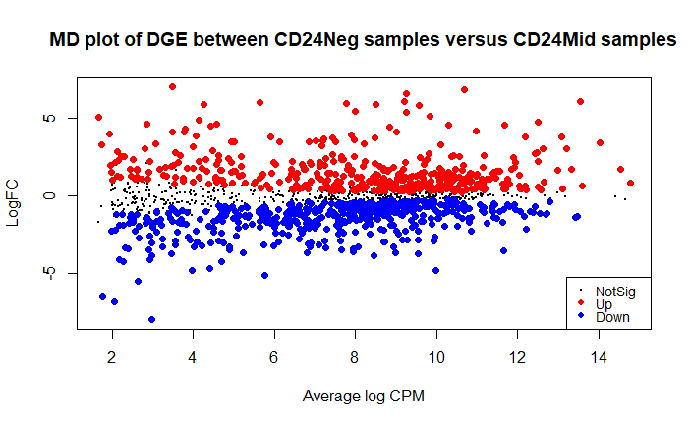
DGE: Mean difference (MD) plot
Results from exactTest of the DGEList portrayed in MD plot
423 up
468 down
413 not significant
Notes:
I’ve included this plot again to represent the results from the DGE list, which were used for the GO analysis in R. The gene list submitted into DAVID analysis contained the significantly up and down regulated genes (red and blue dots).
I created a mean difference plot to show the distribution of genes that were significantly up or down regulated and those that showed little change or did changed but not significantly.
Of the 1304 differentially expressed genes 699 genes were expressed higher in CD24Mid samples and 605 were expressed higher in CD24Neg samples.
Of the genes that were significantly differentially expressed, 423 were up regulated, 468 were downregulated and 413 were not significant (shown by dots on the MD plot).

Slide 15
Examples
GO:0016020 CC – Membrane - many of the top DE genes are linked to membrane components
Up: TMIGD1; SLC47A1; ACE; SLC16A3; RAB11FIP4; SLC22A4
Down: NUP85; MYBP1A; NPM1
MMU:03460 Fanconi anemia pathway – pathway enriched for down regulated genes
Pathway required for efficient repair of damaged DNA (ICLs)
Could reflect higher DNA damage repair capacity in stem cells to maintain their ability to self-renew

Slide 16
Conclusion
Continue researching GO and KEGG terms
Further investigate involvement of Wnt/β-catenin signalling pathway
Investigate other pathways
PPAR, HIF-1, Hippo, apelin
Title suggestion: ‘Comparative RNA-sequencing analysis of gene activity during mouse intestinal differentiation as a model for adult stem cell differentiation’

